Slide 1
Secure Web Programming
Lecture 5. Server-side Scripting
PHP & mysql – shopping mall example
Amanda.Lunt@utas.edu.au
Soonja.Yeom@utas.edu.au

Slide 2
Topics
Secure Web Programming
Week13
Review
Basic Web Programming
Web Security
Adv. Web Programming
Fundamentals – protocol, CS model, etc.
HTTP Protocols, Storage
Advanced Web Applications
Human Computer Interaction with Web Page Design
Security Issues and Technologies
Session management
Client-side Scripting Language and Document Object Model
Secure Programming and Users
Common Gateway Interface
Server-side Scripting Language and Privilege configuration
Encryption and Authentication
Advanced Security Issues

Slide 3
What we have done
Demo, example, alacritas – results live
Form example on chrome
Absolute addressing vs relative addressing
<img src=“http://amazon.com/resources/img1.png ...>
<img src=“/img/menu_lazenby.png>
CSS, class, id
W3schools.com
Csszengarden.com
CSS + pages (HTML, PHP)

Slide 4
Self Study 4 & 5
File management
MySQL, MySQL and PHP

Slide 5
Review: HTML – PHP - MySQL
Web browser
Server
Database
PHP
MySQL
HTML
HTML Form + Super global variable
eg) $_GET, $_POST
MySQL connection

Slide 6
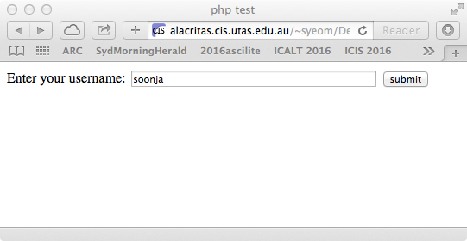
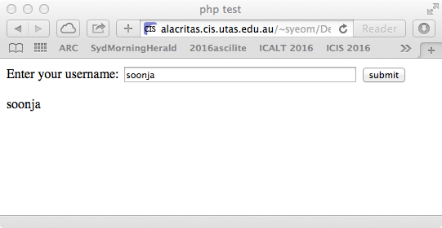
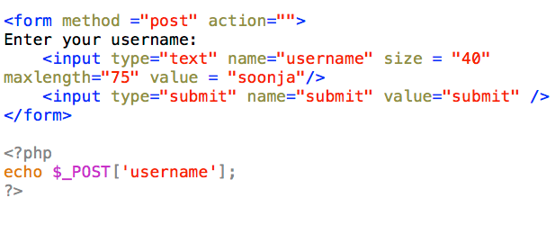
Review: HTML Form with PHP
To receive HTML form input from the server-side:
Use Superglobal variables
Ex) $_GET[ var ] / $_POST[ var ]

Slide 7
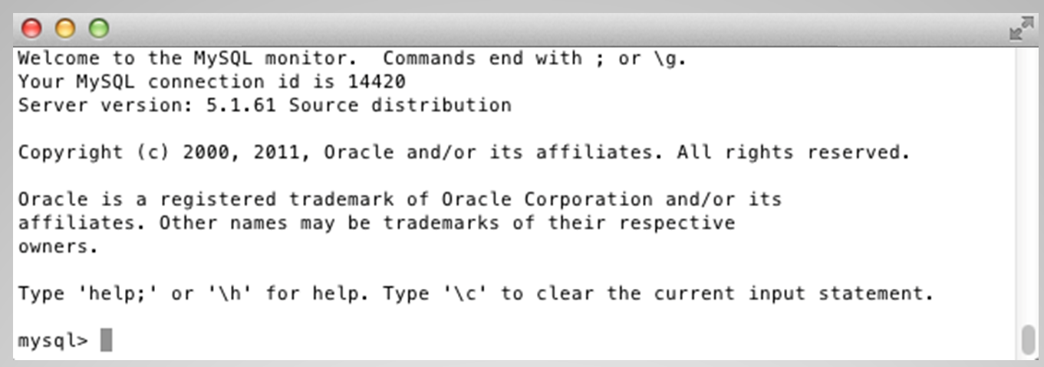

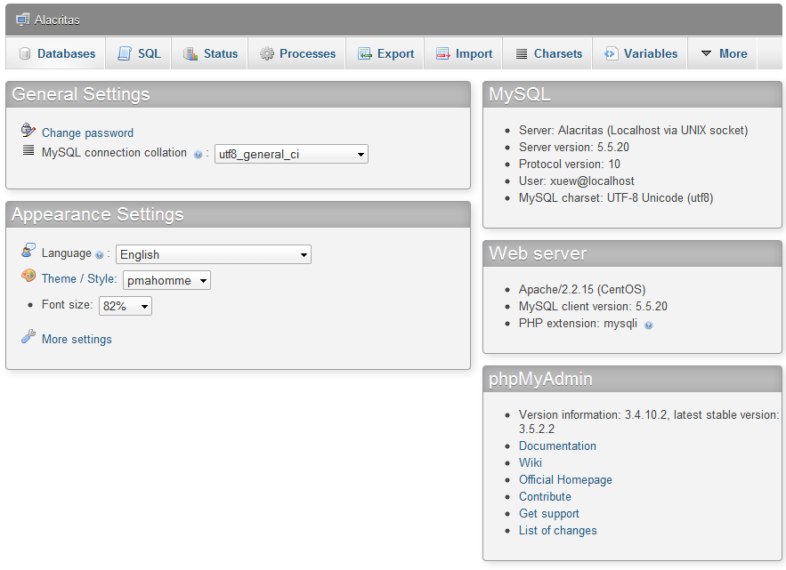
Review: How to use the Database
We will use MySQL as a Database in this unit
How to use (manipulate) the Database
Use terminal – Command line
Use the tool - phpMyAdmin

Slide 8
Review: PHP - MySQL
PHP supplies many built-in functions to interact with a MySQL.
Steps for connecting PHP to MySQL
connect to a database
transfer a query to a database and receive results
process or display results
close the connection

Slide 9
Review: SQL Queries
INSERT INTO table_name
(column_name, column_name, …)
VALUES
("first_value", "second_value", …);
UPDATE table_name
SET column_name1=expression1,
column_name2=expression2, …
WHERE conditions;
DELETE FROM table_name WHERE condition;
SELECT column_name1, column_name2,… FROM table_name;
SELECT column_name1, column_name2, … FROM table_name WHERE condition;

Slide 10
Last lecture
HTML– PHP – Database
Connecting to MySQL & phpMyAdmin
Commands for Databases
Index
Projection & Selection
Multiple tables: Primary key & Foreign key
Connecting PHP to MySQL

Slide 11
Today’s Lecture
SQL Query
Dealing with errors
Storing data in securely
Online shopping mall Process
State Management (next week)
Notes:
I

Slide 12
SQL: Comparison operators
Comparison operators for WHERE clauses
Operator | Example | Description
= | customerid = 3 | Tests whether two values are equal
> | amount > 60 | Tests whether one value is greater than another
< | amount < 60 | Tests whether one value is less than another
>= | amount >= 60 | Tests whether one value is greater than or equal to another
<= | amount <= 60 | Tests whether one value is less than or equal to another
!= or <> | quantity != 0 | Tests whether two values are not equal
IS NOT NULL | ID is not null | Tests whether a field contains a value

Slide 13
SQL: Aggregate Functions
Aggregate Functions in SQL
Name | Description
AVG(column) | returns the average value of a numeric column.
COUNT(column) | returns the number of rows that matches a specified criteria.
MIN(column) | returns the smallest value of the selected column.
MAX(column) | returns the largest value of the selected column.
SUM(column) | returns the total sum of a numeric column.
GROUP BY | is used in conjunction with the aggregate functions to group the result-set by one or more columns.
HAVING aggregate_function (column) operator value | HAVING clause was added to SQL because the WHERE keyword could not be used with aggregate functions

Slide 14
Aggregate functions Example
COUNT(column)
SUM(column)& GROUP BY
SUM(column), GROUP BY & HAVING
SELECT COUNT(customerID) AS Customer991345 FROM transaction WHERE customerID=991345;
SELECT customerID,SUM(quantity) FROM transaction GROUP BY customerID;
SELECT customerID,SUM(quantity) FROM transaction GROUP BY customerID HAVING SUM(quantity) < 20;

Slide 15
SQL: JOIN & UNION
Types of JOIN
UNION
Name | Description
INNER JOIN | returns rows when there is at least one match in both tables.
LEFT JOIN | returns all rows from the left table (table_name1), even if there are no matches in the right table (table_name2).
RIGHT JOIN | returns all the rows from the right table (table_name2), even if there are no matches in the left table (table_name1).
Name | Description
UNION | combines two or more SELECT statements.

Slide 16
JOIN & UNION Example
INNER JOIN
SELECT customer.email, transaction.transactionID FROM customer INNER JOIN transaction ON customer.CustID=transaction.customerID;
LEFT JOIN
SELECT customer.email, transaction.transactionID FROM customer LEFT JOIN transaction ON customer.CustID=transaction.customerID;
UNION
SELECT fullname FROM student_LTN UNION SELECT fullname FROM student_HBA;

Slide 17
To deal with errors in SQL
We need to know that all "queries" return a result
a result object (for SELECT, SHOW, DESCRIBE, EXPLAIN) queries
true - for other sorts of queries that succeed (i.e. INSERT, CREATE, UPDATE, etc.)
false - for any query that fails
in this case the error member of the mysqli object will contain information about the error
How to deal with errors
Preprocessing
Post processing

Slide 18
1) Preprocessing
Understand how the database will be used
what are they looking for in the database
what do they want to enter into the database
Validation is very important
do not want to break the query or (worse still) break the database. See later slides about SQL "injection" attacks.
Suitable data format
Data in the form the user provides it (even when valid) may not be in a suitable format to use in the database - may need some processing / conversion. See later slides about dates / times

Slide 19
2) Post Processing
A query that returns data from the database returns a result object - to use the data need to:
extract the information from the result object
store it in a suitable data structure
display it on the web page (usually)
Even when extracted, the data may need some conversion and / or processing before being suitable for display.

Slide 20
How to do pre/post processing
Both PHP and MySQL have a large collection of built in functions that help with the processing. In each case need to choose whether to:
Use PHP functions
Use MySQL functions
Use a combination
not always an obvious decision - in many cases both PHP and MySQL have functions that would do the job
in this unit we will mainly use PHP functions (to save the extra syntax of using MySQL functions!)

Slide 21
Handling dates
Storing dates in MySQL
There are a number of column datatypes especially for storing dates / times
DATETIME type stores values that contain both date and time information.
DATE type stores only a date value, without a time part
TIMESTAMP type stores values in essentially the same way as the DATETIME type
TIMESTAMP columns can be set to automatically update to the time when an action occurs (for example the record is added to the database)

Slide 22
Manipulating dates
Both PHP and MySQL have many functions to manipulate and format dates
PHP- has date() function
1st parameter - formatting string (remember the long list of options)
2nd parameter - the date to format as a UNIX timestamp
MySQL has DATE_FORMAT function
1st parameter - the date to format in MySQL 'YYYY-MM-DD HH:MM:SS’ format
2nd parameter - formatting string (using MySQL's long list of completely different formatting options)

Slide 23
Storing the information securely
How to store the information?
username
type: VARCHAR of the length required (max allowed length of username)
values: the usernames in plain text
password - the same sort of thing?
storing passwords in plain text anywhere is a bad idea
"encode" the password (one way encoding) and store the encoded version
to check - encode what the user enters and compare that with what is in the database

Slide 24
Storing the information securely
Steps
create a table with a column to store the password "fingerprints"
e.g. use VARCHAR(40) - do not use CHAR incase the last digit is blank
when a user "signs up" - that is accepted as an authorised user
use PHP to calculate the MD5 or SHA "fingerprint" of the password they chose and store this (along with their username and any other relevant information) in a database table
Form Handling – Sanitizing

Slide 25
<?php $hashed_password = crypt('mypassword');
// let the salt be automatically generated if (hash_equals($hashed_password, crypt($user_input, $hashed_password))) { echo "Password verified!"; } ?>
In relation to the shopping example (MD5)-more info in the following lecture (shopping in week 5, security in week 7)
MD5, SHA, or anything else for encrypting at least password.
Cracked algorithms?
http://php.net/manual/en/function.crypt.php

Slide 26



Simple Online Transaction
Customer
Shopping Mall Server/Database
Q. What tables do we need in the database?

Slide 27
Shopping Mall DB-tables
tb_customer stores customer details
tb_item stores the details of the items (including price and quantity)
tb_cart stores the user of cart, record whether the payment is made
tb_transaction stores the records of the transactions

Slide 28
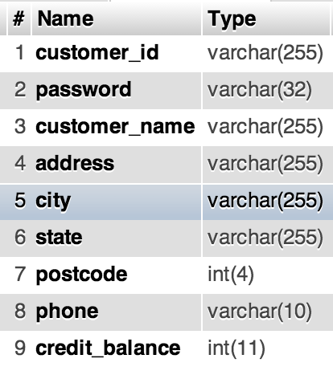
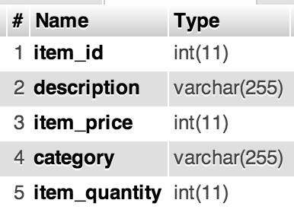
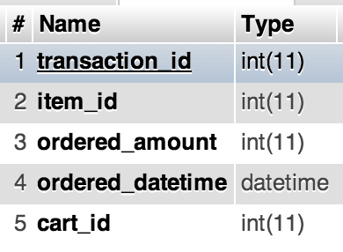
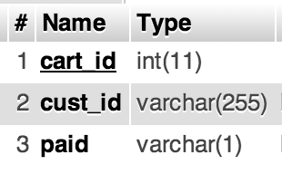
Structure of tables
tb_customer
tb_item
tb_transaction
tb_cart

Slide 29
User View of the System
Log in
View Cart
Category List
Add item to cart
Checkout
Category: Item List
Process Payment

Slide 30
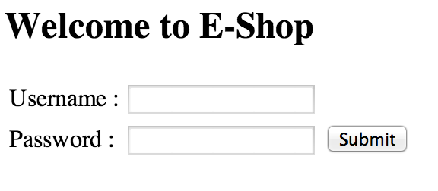
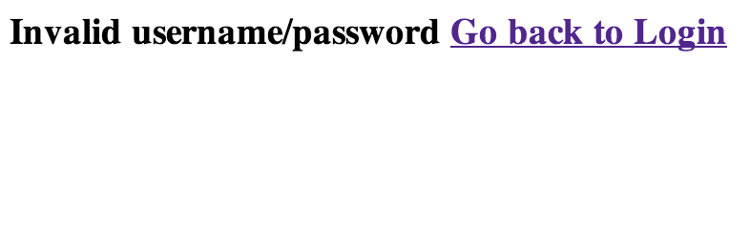
Username/ Password Validation
Success
Fail

Slide 31
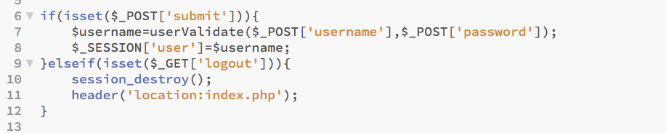
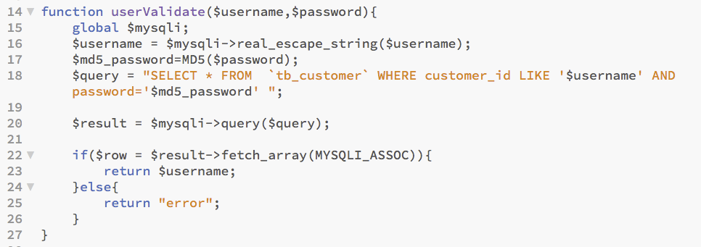
Username/ Password Validation

Slide 32
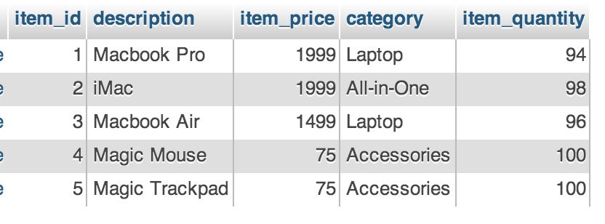
Extract category list
[tb_item]
[index.php]
extract

Slide 33
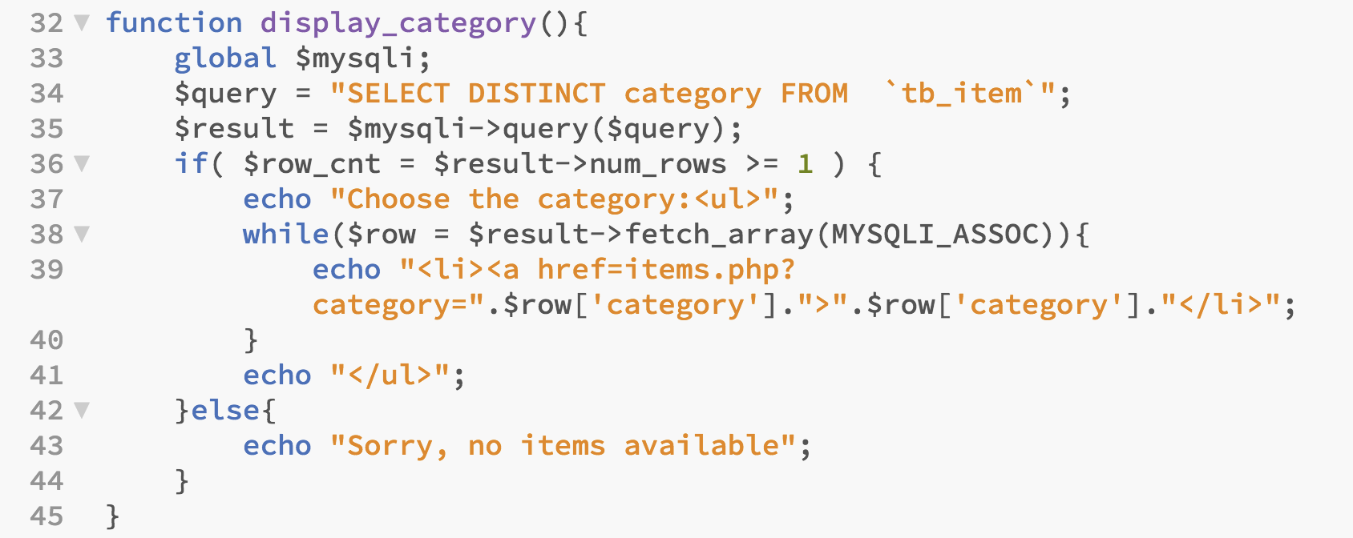
Extract category list
display_category();

Slide 34
Extract Item list with details (only selected category)
[items.php]
[tb_item]
extract

Slide 35
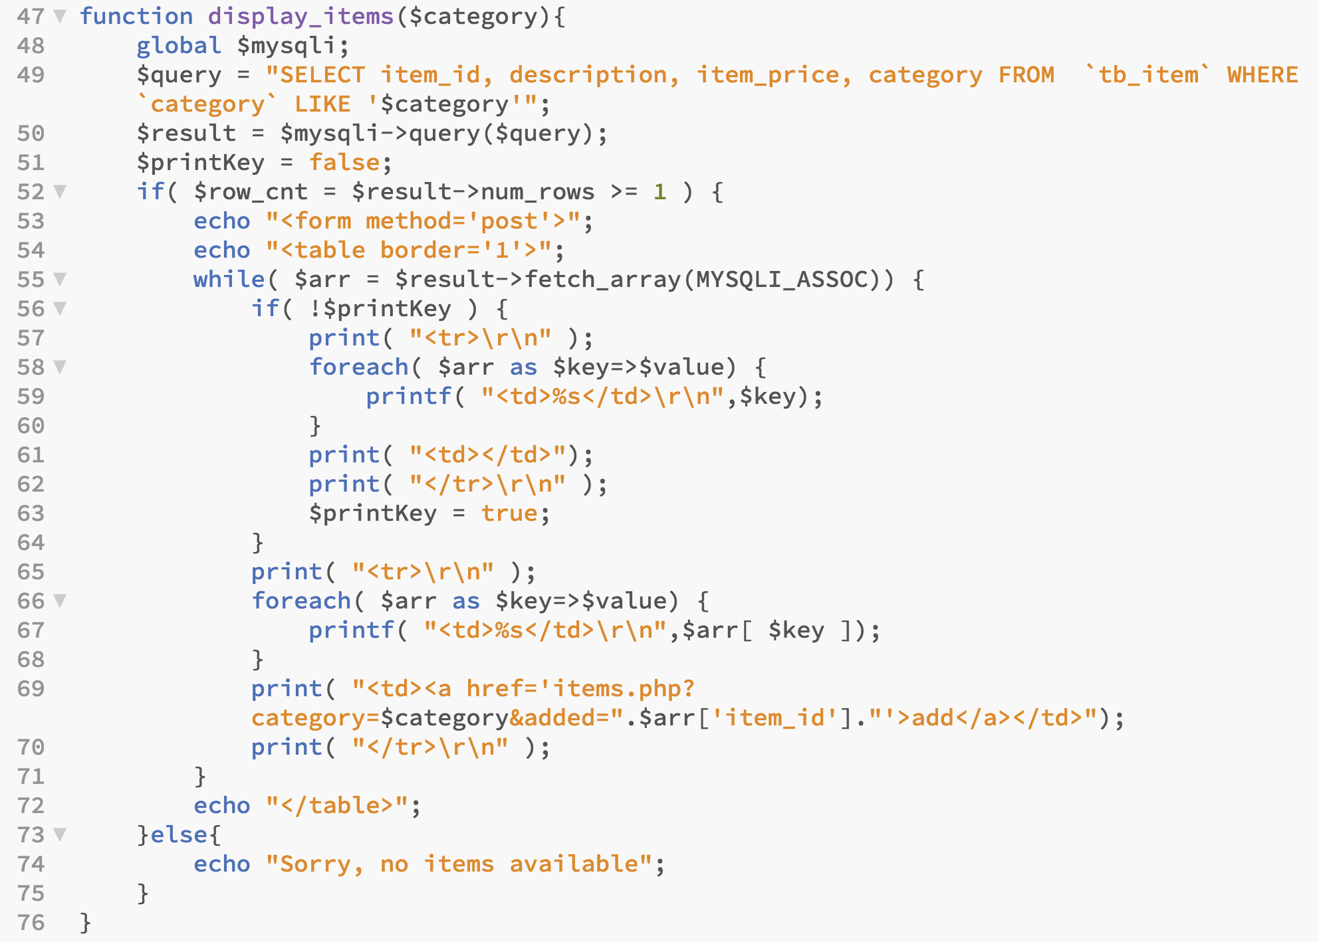
Extract Item list with details (only selected category)
display_items($_GET['category']);

Slide 36
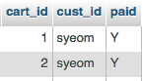
Add Item in the database
[items.php]
[tb_cart]
add
add
[tb_transaction]

Slide 37
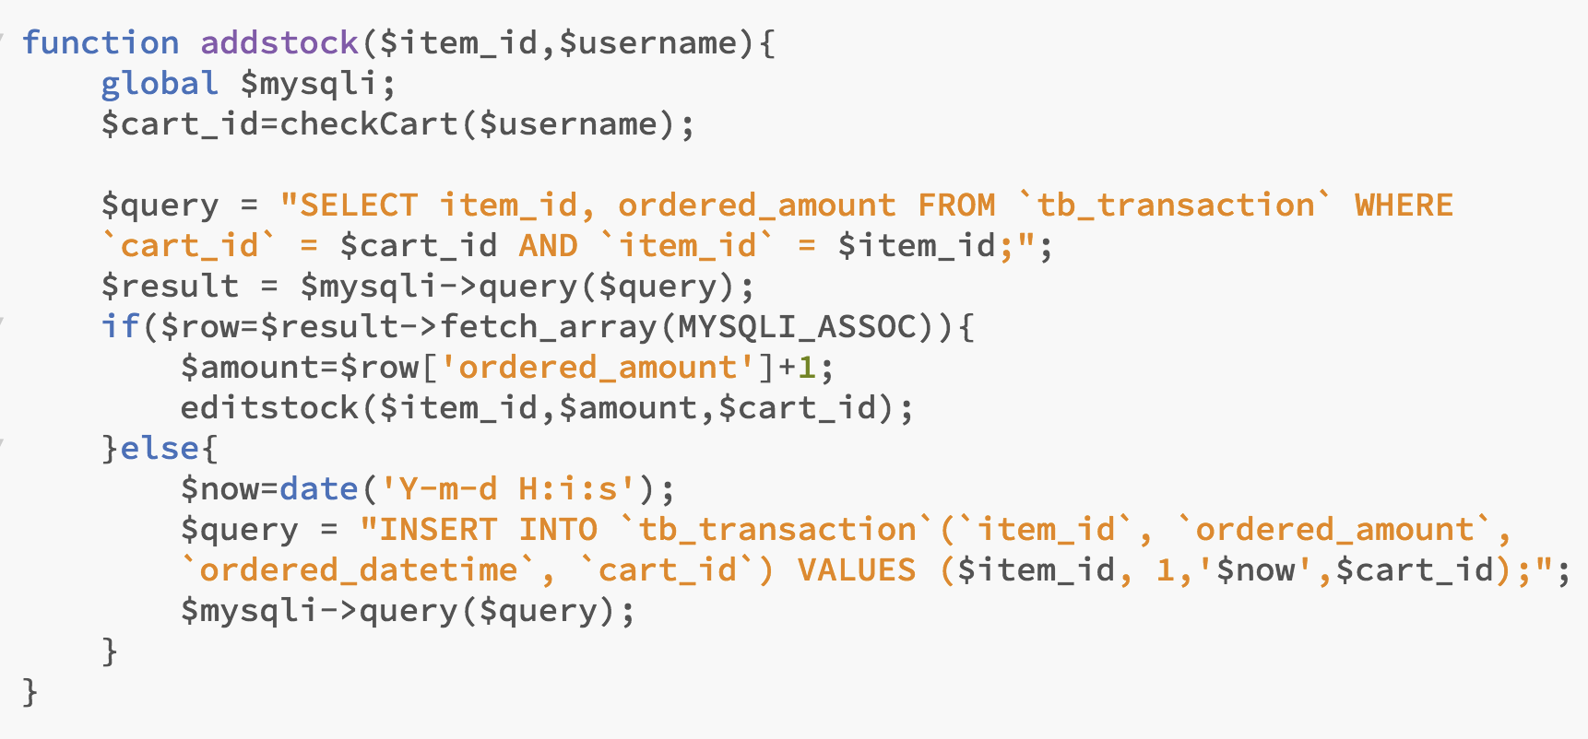
Add Item in the database
if(isset($_GET['added'])){
addstock($_GET['added'],$_SESSION['user']);
}

Slide 38
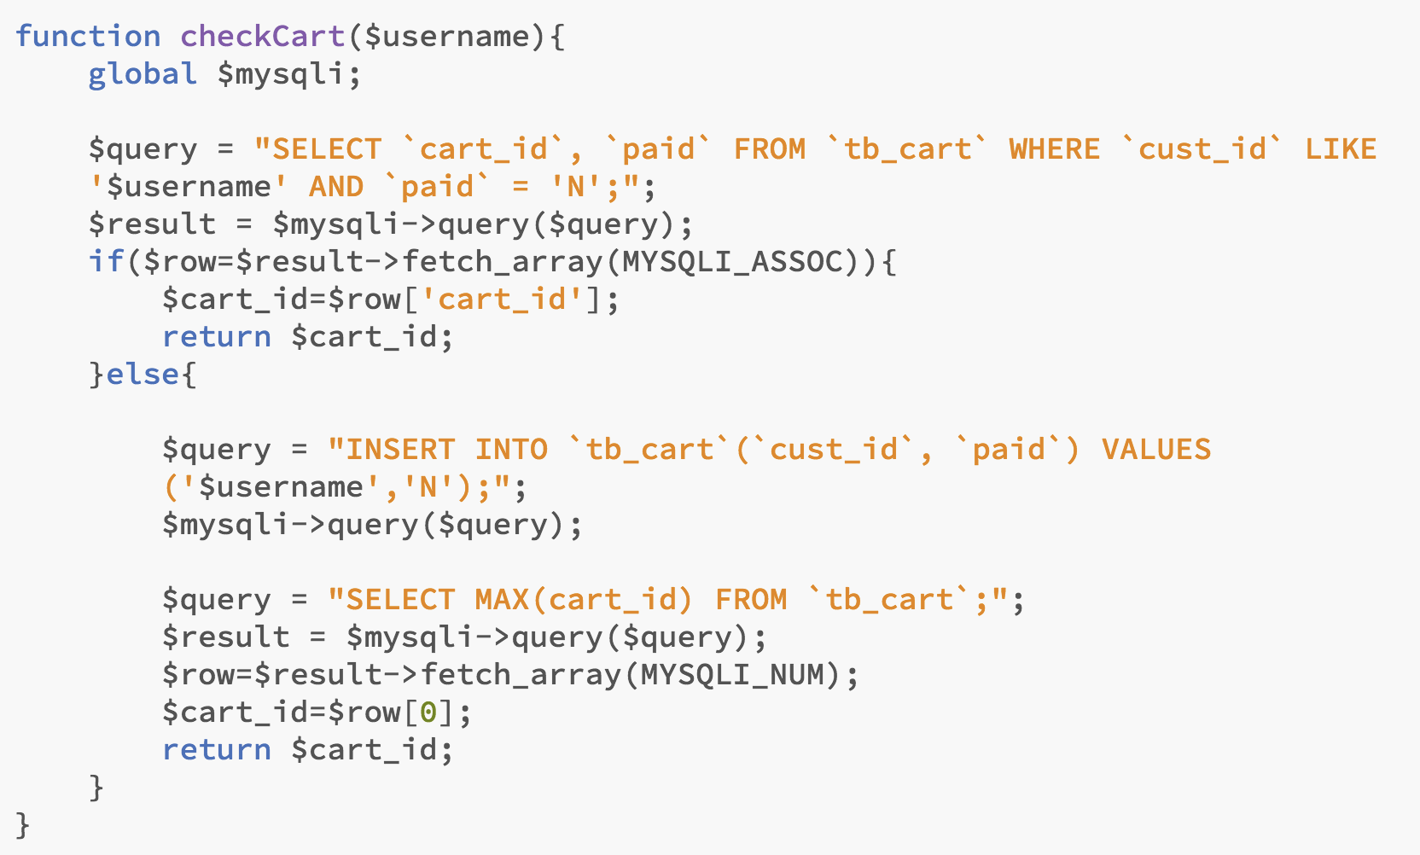

Slide 39
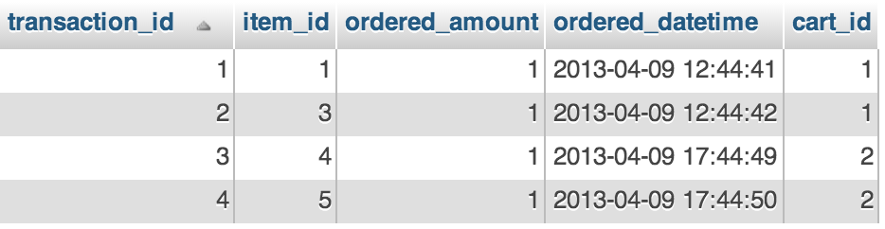

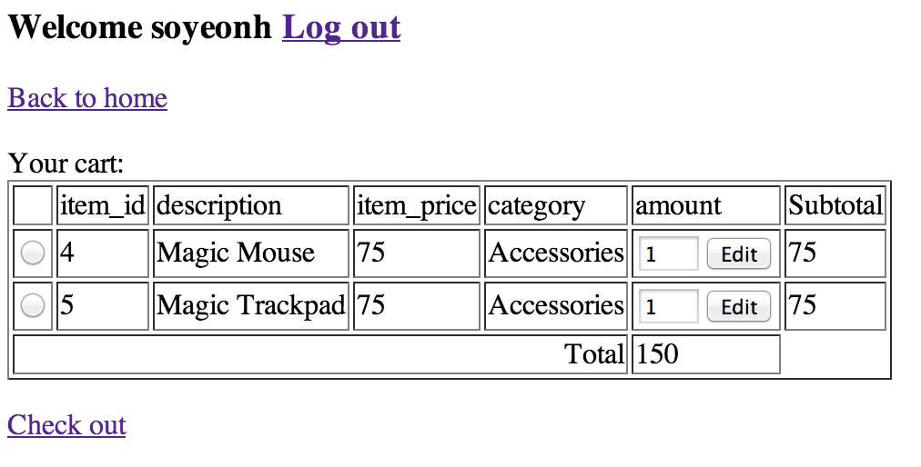
Extract added items/Edit amount
[tb_transaction]
[cart.php]
edit
extract

Slide 40
Extract added items/Edit amount
$cart_id=checkCart($username);
display_cart($cart_id);
function display_cart($cart_id){
global $mysqli;
$item_query = "SELECT item_id, ordered_amount FROM `tb_transaction` WHERE `cart_id` = $cart_id";
$item_result = $mysqli->query($item_query);
$num = $item_result->num_rows;
if($num==0){
echo "Your cart is empty";
}else{
echo "Your cart:";
echo "<form method='post'><table id='cart' border='1'>";
while( $row = $result1->fetch_array(MYSQLI_ASSOC)) {
…print out results in the table format with <input> tag…
}
echo "<input type='hidden' name='edit' value='true'>";
echo "<tr><td colspan=5 align=right>Total</td><td>$total</td>";
echo "</table></form>";
echo "<a href='checkout.php'>Check out</a>";
}
}

Slide 41
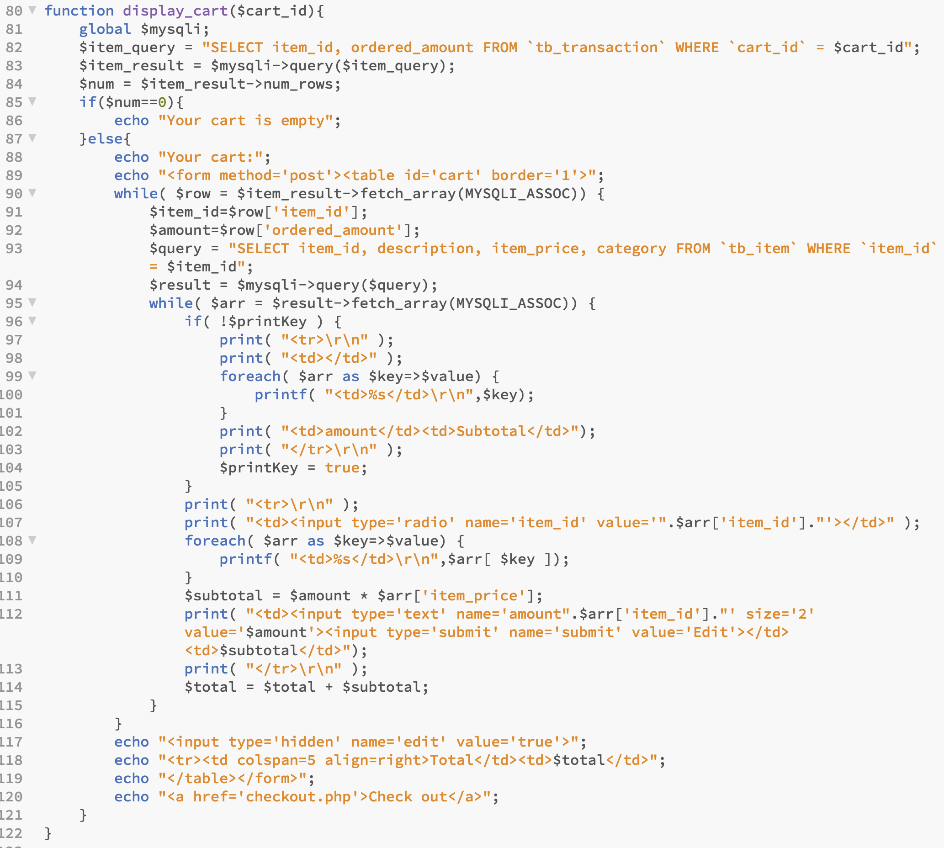

Slide 42
Extract added items/Edit amount
if(isset($_POST['item_id'])){
$cart_id=checkCart($username);
$item_id=$_POST['item_id'];
$amount="amount".$item_id;
editstock($item_id,$_POST[$amount],$cart_id);
}
function editstock($item_id,$amount,$cart_id){
global $mysqli;
$amount = $mysqli->real_escape_string($amount);
$query = "UPDATE `tb_transaction` SET `ordered_amount`=$amount WHERE `item_id` = $item_id AND `cart_id` = $cart_id;";
$mysqli->query($query);
}

Slide 43
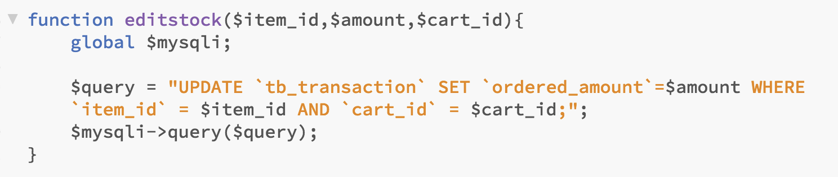

Slide 44
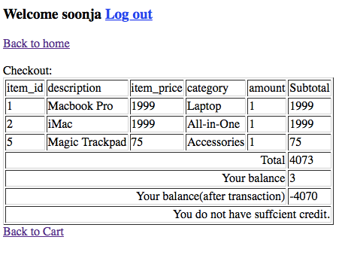
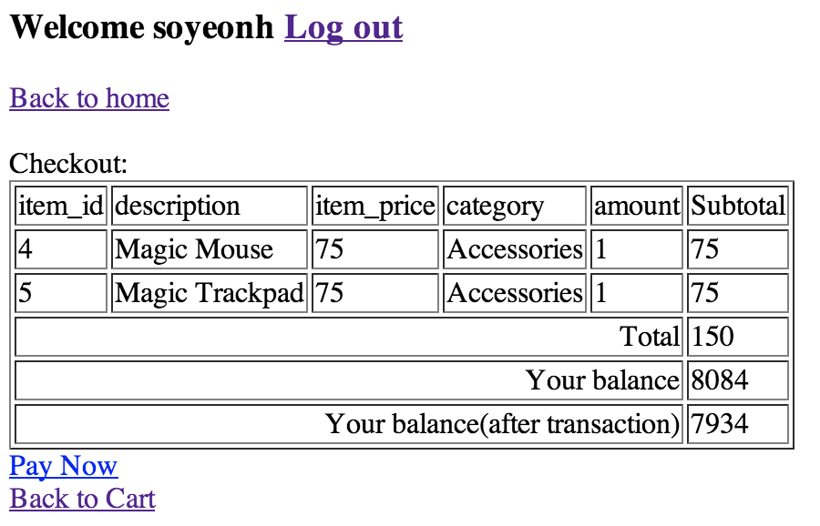
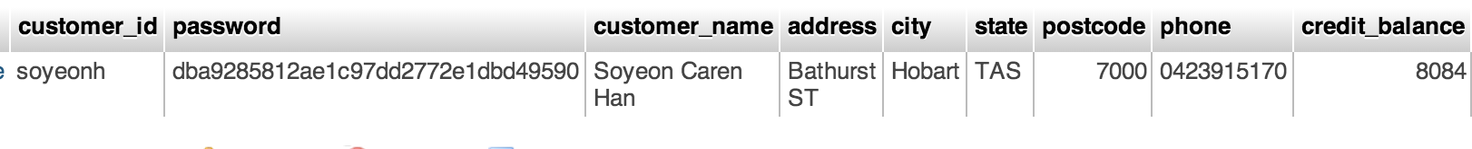
Check out and Process payment
[checkout.php]
extract
edit
[tb_customer]

Slide 45
Check out and Process payment
$cart_id=checkCart($username);
display_checkout($cart_id,$username);
function display_checkout($cart_id,$username){
…same as display_cart except <input> tag…
$query = "SELECT credit_balance FROM `tb_customer` WHERE `customer_id` LIKE '$username'";
$result = $mysqli->query($query);
$row = $result->fetch_array(MYSQLI_ASSOC);
echo "<tr><td colspan=5 align=right>Your balance</td><td>". $row['credit_balance']."</td>";
$after_balance=$row['credit_balance']-$total;
echo "<tr><td colspan=5 align=right>Your balance(after transaction)</td><td>$after_balance</td>";
if($after_balance<0){
echo "<tr><td colspan=6 align=right>You do not have sufficient credit.</td></tr>";
}
echo "</table>";
if($after_balance>=0){
echo "<a href='pay.php?paynow=true&afterbalance=$after_balance'>Pay Now</a><br/>";
}
}

Slide 46
Check out and Process payment
if($_GET['paynow']=='true'){
echo "Thank you.<br/>";
echo "Transaction completed.";
$after_balance=$_GET['afterbalance'];
$cart_id=checkCart($_SESSION['user']);
complete_transaction($_SESSION['user'],$after_balance,$cart_id);
}
function complete_transaction($username,$after_balance,$cart_id){
global $mysqli;
$mysqli->query('SET autocommit = OFF;');
$mysqli->query('START TRANSACTION;');
$item_query = "SELECT tb_item.item_id, ordered_amount, item_quantity FROM `tb_item` LEFT JOIN tb_transaction ON tb_transaction.item_id=tb_item.item_id WHERE tb_transaction.cart_id = $cart_id;";
$item_result = $mysqli->query($item_query);
while($row=$item_result->fetch_array(MYSQLI_ASSOC)){
$item_id=$row['item_id'];
$amount=$row['ordered_amount'];
$quantity=$row['item_quantity'];
$remain=$quantity-$amount;
continued…

Slide 47
Check out and Process payment
continued…
$query = "UPDATE `tb_item` SET `item_quantity`=$remain WHERE `item_id`=$item_id;";
if(!$result = $mysqli->query($query)){
$mysqli->query('ROLLBACK;');
exit;
}
}
$query = "UPDATE `tb_customer` SET `credit_balance`=$after_balance WHERE customer_id = '$username';”;
if(!$result=$mysqli->query($query)){
$mysqli->query('ROLLBACK;');
exit;
}
$query = "UPDATE `tb_cart` SET `paid`='Y' WHERE cart_id=$cart_id;";
$mysqli->query($query);
if(!$result=$mysqli->query($query)){
$mysqli->query('ROLLBACK;');
exit;
}else{
$mysqli->query('COMMIT;');
}
}

Slide 48
Thank you
Any Questions

